Slide 1
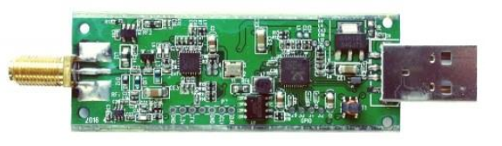
The RTL2832 SDR Dongle
Russell Silva – AMRUPT, Spring ‘18

Slide 2
General Information
“RTL-SDR is a very cheap software defined radio that uses a DVB-T TV tuner dongle based on the RTL2832U chipset. With the combined efforts of Antti Palosaari, Eric Fry and Osmocom it was found that the signal I/Q data could be accessed directly, which allowed the DVB-T TV tuner to be converted into a wideband software defined radio via a new software driver.” – rtl-sdr.com
“The whole RTLSDR thing is fluke and not an intentional product. Basically 1.5 years ago someone discovered a stealth test mode on a commercial satellite TV receiver USB and it popped up on Reddit and the rest is history.” – Reddit Post
The nature of the semiconductor and electronics industries in Asia is highly competitive so they are über paranoid about sharing information.” – Reddit Post
“An enterprising hacker, Eric Fry, found that the device sends IQ data over the USB connection that can allow us to use it as an SDR. A lot of smart folks wrote code for linux, windows, etc and now we can use that IQ data as a means to listen to and view signals that the RTLSDR receives.” – Reddit Post
Notes:
There are many other software defined radios better than the RTL-SDR, but they all come at a higher price. Currently we think that the Airspy ($199) and SDRPlay ($149) SDR’s are the best low cost RX only SDR’s. Then there are the HackRF ($300USD) and BladeRF SDRs ($420 and $650), which can both transmit and receive.

Slide 3
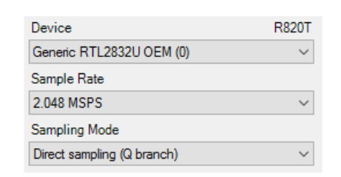
Concerns:
Highest Safe Sampling Rate of the I/Q Extraction: 2.56 MS/s (Superkuh)
Superheterodyne devices – Employs IF mixing; however, it is unclear whether I/Q signals can be taken after this stage
No Formal Datasheet
RTL-SDR Blog V3 Datasheet
(rtl-sdr.com)
Notes:
The highest safe sample rate is 2.56 MS/s but in some situations up to 3.2 MS/s works without USB dropping samples (RTL2832U drops them internally).

Slide 4
Clock selector jumper
Clock selector jumper – “By soldering in a 4 pin 1.27mm pitch jumper header and removing the default 0 Ohm resistor, one can now easily select between the onboard clock, an external clock, or having the on board clock be the output for another dongle. This is for advanced users only who want to experiment with things like passive radar, and coherent receivers.” (RTL-SDR Blog V3 Datasheet – rtl-sdr.com)

Slide 5
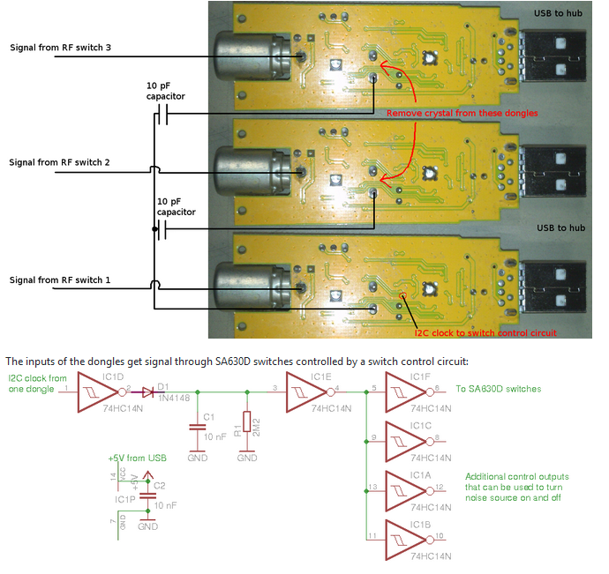
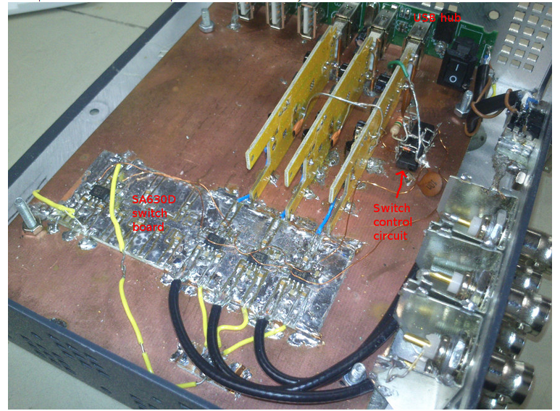
Phase Interferometry Project using RTL SDRs (tejeez – Github)

Slide 6
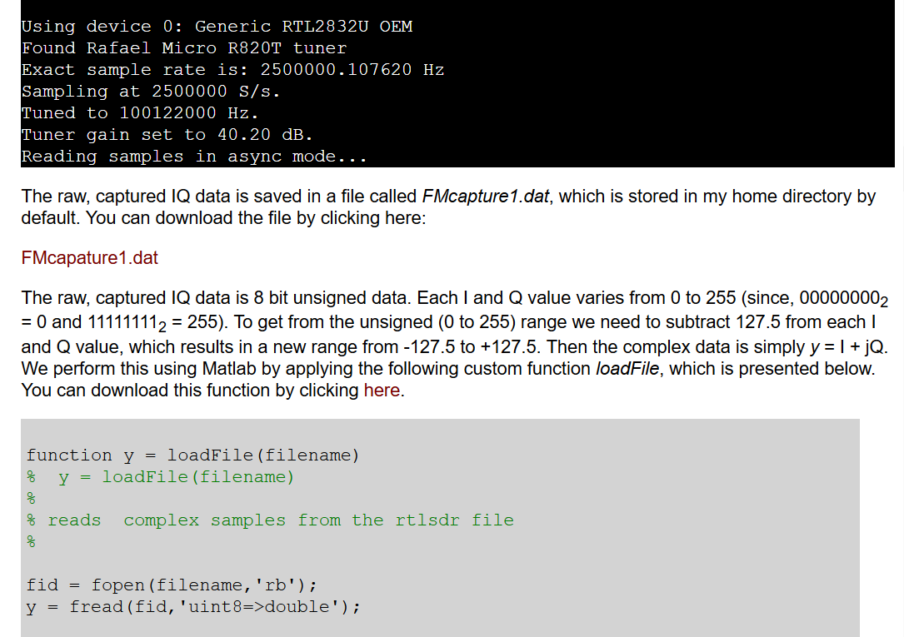
GNU Radio Software:
“How to capture raw IQ data.” (Dr. Aaron Scher, 2015)

Slide 7
Sources:
http://superkuh.com/rtlsdr.html: “Central Hub” source for RTL SDR Information
https://github.com/tejeez/rtl_coherent: Phase Interferometry Project using RTL SDRs
https://www.reddit.com/r/RTLSDR/comments/6n9hdk/welcome_new_visitors_a_little_info_about_rtlsdr/ Reddit Post detailing how RTL SDRs became popular
https://www.rtl-sdr.com/about-rtl-sdr/: General Information
https://www.rtl-sdr.com/buy-rtl-sdr-dvb-t-dongles/: Buying Location
aaronscher.com/wireless_com_SDR/RTL_SDR_AM_spectrum_demod.html “How to capture raw IQ data,” (Dr. Aaron Scher, 2015)

Slide 8
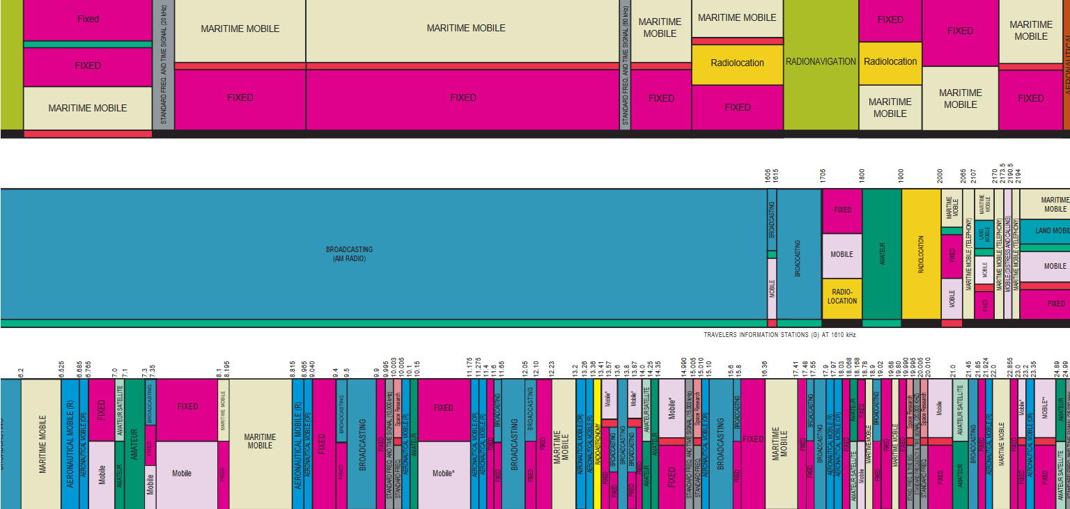
Keep in Mind: U.S. Frequency Allocation:

